Slide 1

Video Game Recommender Systems
Stanley Tran

Slide 2
Agenda
Introduction
Recommendation Models
Popularity-based recommender system
ALS collaborative filtering
Conclusion
References

Slide 3
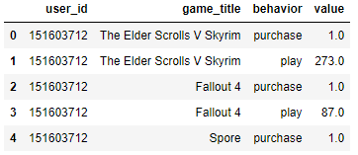
Video Game Recommender Systems Introduction
Recommender System: subclass of information filtering system to predict the preference or interest in which user gives to an item
Companies using recommender system: Amazon, YouTube, Netflix and more
Datasets from Steam Video Games used to build recommender system to recommend games based on users’ preferences and their gaming habits
Variables definitions:
user_id: ID of the users
game_title: Title of the game
behavior: “purchase” or “play”
value: number of hours the user played the game

Slide 4
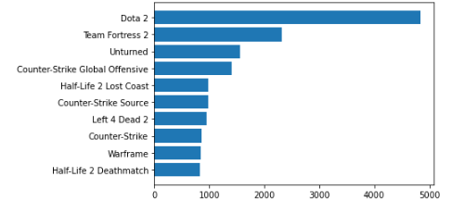
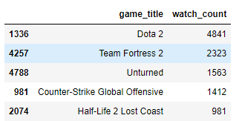
Video Game Recommender Systems Recommendation model: Popularity-based recommender system
Analysis of the most purchased games by the users: filter the data to have only the purchased games and do a sum to do the count

Slide 5
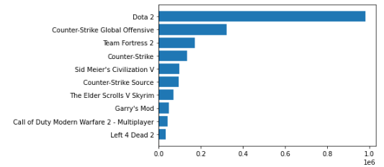
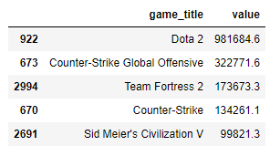
Video Game Recommender Systems Recommendation model: Popularity-based recommender system
Analysis of the most hours played games by the users: filter the data to have only the played games and do a sum of the hours played for each of the game

Slide 6
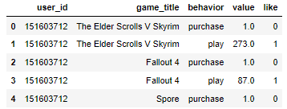
Video Game Recommender Systems Recommendation model: ALS collaborative filtering
Create a column named ‘like’. If the game is played more than 60 hours (number I randomly select), then it means that the user really likes the game (labelled as 1) or else, labelled as 0

Slide 7
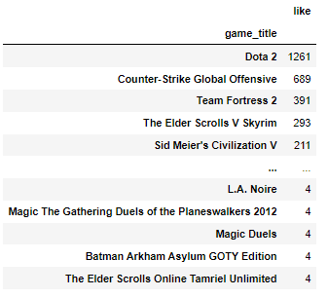
Video Game Recommender Systems Recommendation model: ALS collaborative filtering
Create a subgroup to identify which games are the most liked by summing the number of likes for each game

Slide 8
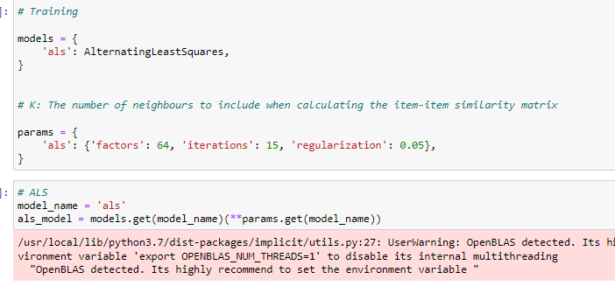
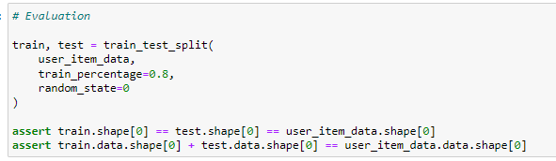
Video Game Recommender Systems Recommendation model: ALS collaborative filtering
Processes: Use sparse matrix with the user_id and the game_title, while creating mapping dictionaries, relist of extra games to filter from personalized list, reduce impact of users having purchased the same games many times and reduce the weight given to popular games (e.g. using BM25 weight –> COO Matrix)
Use ALS model with the following parameters to train the model:

Slide 9
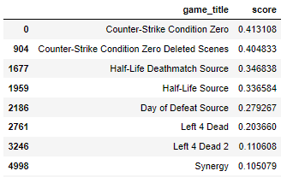
Video Game Recommender Systems Recommendation model: ALS collaborative filtering
Single user prediction: user_id = “5250”

Slide 10
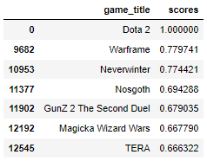
Video Game Recommender Systems Recommendation model: ALS collaborative filtering
Item-to-item recommendation with game_title = “Dota 2”

Slide 11
Video Game Recommender Systems Conclusion
Experiment using popularity-based recommender system and ALS collaborative filtering
The best recommendation algorithm is the one that helps you reach your goal fastest
Assuming the different scenarios:
Goal 1: Find the most popular games regardless of users
Recommendation using popular-based recommender system
Goal 2: Give best recommendation for individual users based on their purchases and time spent playing the game
Recommendation using collaborative filtering
Overall interesting exploration in understanding how to use the different recommender algorithms
Future work: explore using different types of recommender algorithms and do more comparisons, explore in trying to recommend games for new users, build Flask apps for recommending games

Slide 12
Video Game Recommender Systems References
Building a Recommender Engine Part I: Problem Statement & Collecting Data with Selenium | by Rachel Koenig | Medium
Game-Recommendation-System (audreygermain.github.io)
Steam Video Games | Kaggle

